Slide 1
Discussion Leaders: Zahra Fakraahi (University of Pennsylvania)
Sapna Sarupria (Clemson University)
Demographic Bias
Does it exist?
Does it have an impact?
How can we fix it?

Slide 2
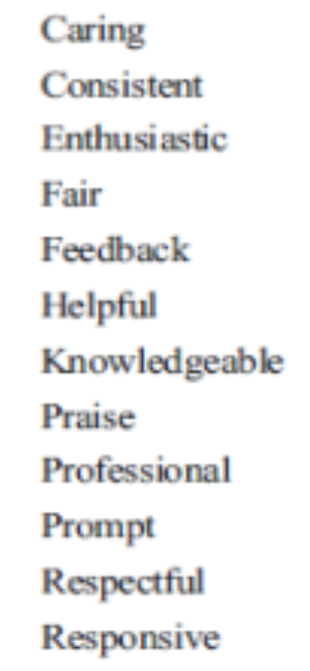
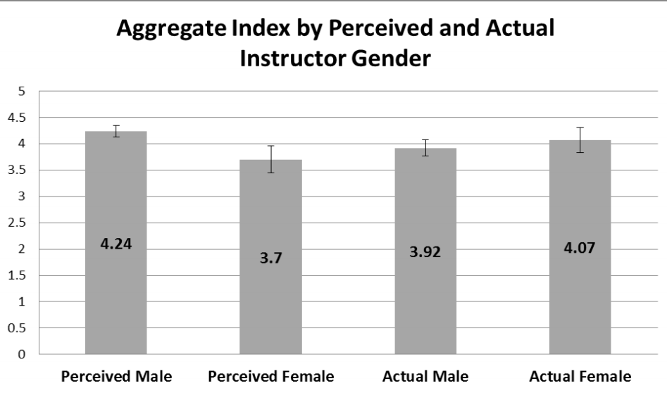
Teaching Evaluations
MacNell, et al. Innov Higher Ed 2015
Assistant instructors in an online class operated under two different gender identities
Students (n = 43) submitted ratings of their teachers at the end of the class
Students rated the male identity significantly higher than the female identity, regardless of the instructor’s actual gender
Gendered Language in Teacher Reviews
http://benschmidt.org/profGender/#

Slide 3
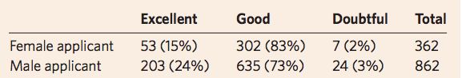
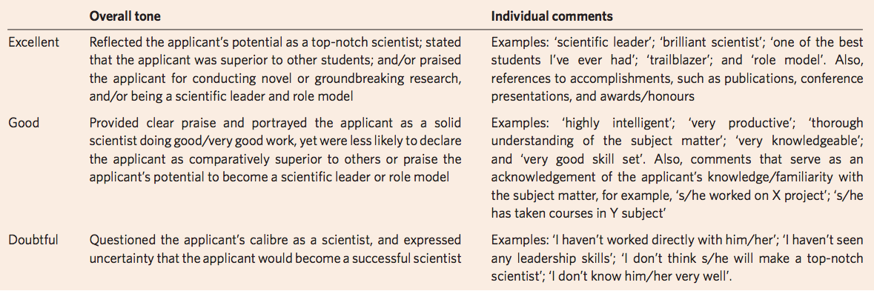
Gender differences in recommendation letters
for postdoctoral fellowships in geoscience
Dutt et al. Nature Geosciences 2016
International data sets of 1224 recommendation letters for postdoctoral fellowships
Analyzed them length & tone:
Female applicants are less likely to receive excellent letters versus good letters compared to male applicants.
Letters for women are shorter than for men.
The gender of the letter writer does not influence the outcomes.

Slide 4
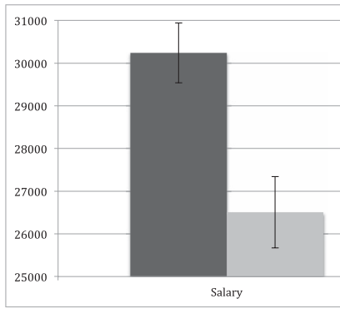
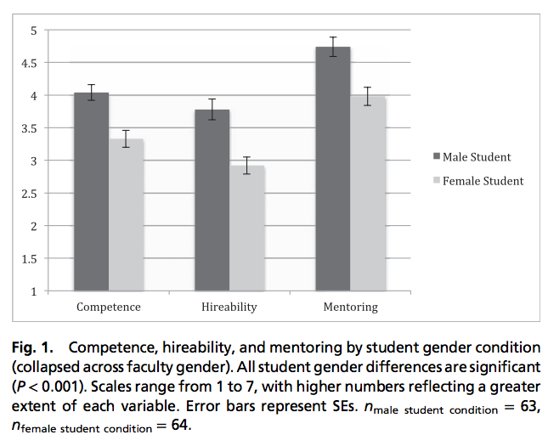
What’s in a name?
Science faculty’s subtle gender biases favor male students
Moss-Racusin, et al. PNAS 2012
Science faculty from research universities rated the application materials of a student—who was randomly assigned either a male or female name—for a laboratory manager position.
Female applicant rated less competent and less hireable.
Male applicant offered 10% higher salary.
Female and male faculty equally biased.

Slide 5

Same researcher, two perceived gender identities:
Ben Barres
Neurobiologist
Underwent a sex change at the age of 42 (female > male)
“The main difference I have noticed is that people who don't know I am transgendered treat me with much more respect" than when he was a woman.”
“I can even complete a whole sentence without being interrupted by a man.”
“I overheard: ‘Ben Barres gave a great seminar today, but then his work is much better than his sister's.”

Slide 6
Funding
Analysis of National Institutes of Health R01 Application Critiques, Impact, and Criteria Scores: Does the Sex of the Principal Investigator Make a Difference?
Kaatz, A., et al., Academic Medicine: August 2016, 91, 1080–1088
Linguistic analysis of NIH grant proposal critiques
stereotype-based beliefs that women lack agentic traits associated with ability (e.g., independence, leadership ability, logic, strength) in male-typed domains that can lead reviewers to doubt women’s competence.
Often unconscious, bias occurs despite explicitly held egalitarian beliefs.
Bias most likely to occur in reviews for high-status position or award
Category | Word examples
Ability | Able, skill
Achievement | Awards, honors
Agentic | Competent, leader, logic, strength
Negative evaluation | Unclear, illogical
Positive evaluation | Solid, feasible
Research | Productivity, grant
Standout adjectives | Exceptional, outstanding
Despite higher incidence of standout adjectives for women in type 2 proposals,
Priority, approach and significance scores worse (higher) for women.

Slide 7
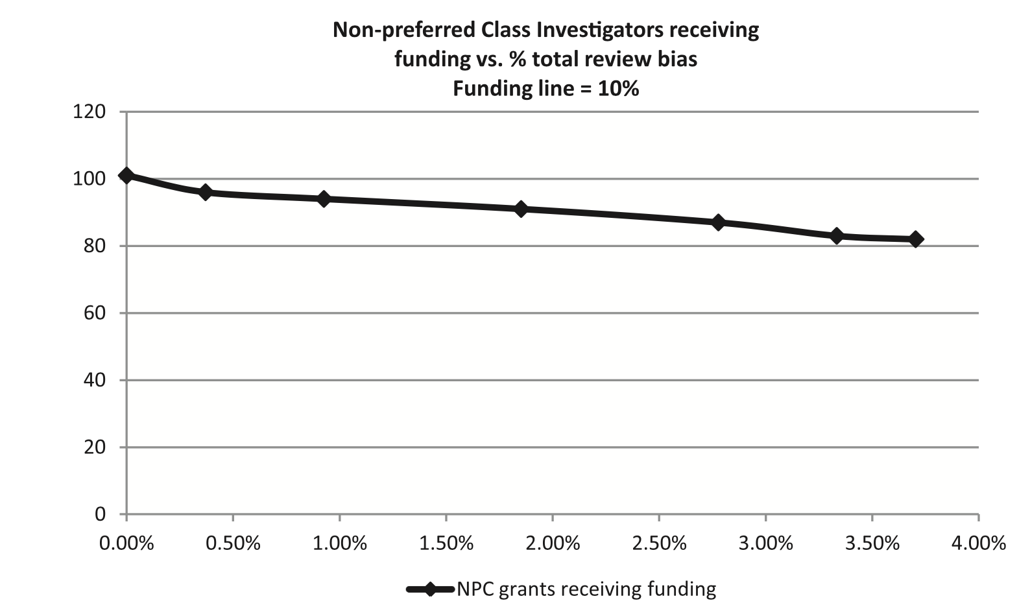
Does demographic bias matter?
The big consequences of small biases: A simulation of peer review
Day . Research Policy 2015
Grant applicants assigned as “preferred class” vs. “non-preferred class”
Ran simulations for grant review process applying a particular level of bias amongst reviewers
Results
A total review bias of 3.7% translates to a 20% lower grant success rate
when 10% of grants are awarded
Careers are cumulative

Slide 8

Demographic Bias
Does it exist?
Does it have an impact?
How can we fix it?

Slide 9
How gender determines the way we speak about professionals
Stav Atir and Melissa J. Ferguson, PNAS June 25, 2018. 201805284
Men and women were, on average across studies, more than twice as likely to describe a male (vs. female) professional by surname in domains, such as science, literature, and politics.
We find that this simple difference in reference affects judgments of eminence, with participants judging those professionals described by surname as more eminent and 14% more deserving of a career award.

Slide 10
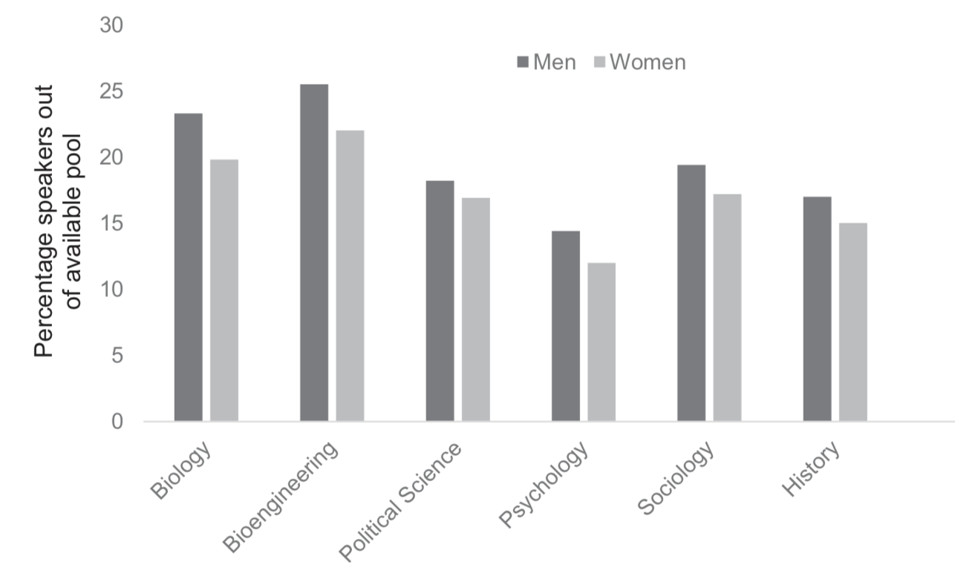
Gender disparities in colloquium speakers at top universities
Christine L. Nittrouera, Michelle R. Hebla, Leslie Ashburn-Nardob, Rachel C. E. Trump-Steelea, David M. Lanea,c, and Virginia Valiand, PNAS, 2018, 114: 104-108
Men were more likely than women to be colloquium speakers even after controlling for the gender and rank of the available speakers.
Eliminating alternative explanations (e.g., women declining invitations more often than men), our follow-up data revealed that female and male faculty reported no differences in the extent to which they (i) valued and (ii) turned down speaking engagements.

Slide 11
Gender disparities in colloquium speakers at top universities
Christine L. Nittrouera, Michelle R. Hebla, Leslie Ashburn-Nardob, Rachel C. E. Trump-Steelea, David M. Lanea,c, and Virginia Valiand, PNAS, 2018, 114: 104-108
Additional data revealed that the presence of women as colloquium chairs (and potentially on colloquium committees) increased the likelihood of women appearing as colloquium speakers.
Our data suggest that those who invite and schedule speakers serve as gender gatekeepers with the power to create or reduce gender differences in academic reputations.

Slide 12
Team Activity: What actions can we take to address the demographic bias
Disclaimer: The points listed in the next few slides describing the suggestions from the team activity are copied as is from the activity sheet and are provided to give a glimpse of the types of topics that were thought of. They represent individual/team views and those remain anonymous.

Slide 13
Suggestions from the team activity
Diversity in application pool → broad search → broad pool
Input in hiring – short list from rest of the Dept.
Diversity speakers/awards → cumulative effect → increase transparency
Reframe topic of symposium etc → mix diversity
Bias while reviewing papers/grants
Motivate & increase participation of women across all levels
Maternity question
Be self-confident; don’t let anyone tell you that you are not good enough
Not disqualifying because of one bad reference
How to teach women and girls to speak up →
  way of teaching/environment; build an environment gender/nationality/accent independent;
  how to eliminate bias/stereotypes in this environment;
  create enough driving force for women in higher positions – REAL career path; outreach activities → gender and diversity balance – making role models;
  “I don’t like chemistry” == “I don’t understand” – active learning

Slide 14
Suggestions from the team activity
The having children barrier: Maternity and paternity leave – starting early?; 1 year on tenure clock not enough but how do you stay caught up in the field.
All women seminars
Wording to solicit the most diverse pool. Less specific requirements
CONSCIOUS inclusion of women/URM in classroom and beyond – hiring, awards, invited talks, important committees
Evaluate language in letters of recommendation
Create opportunities to build community
Incentivizing precedence – encourage questions/speakers, randomizing
Visible, dedicated support – individual, institutional
Maternity – NSF awareness – project and process; time/leave; standard procedure/policy
Work towards changing the culture – outreach, visibility, support system, peer icons + role models
Resources. → centralized
Accountability

Slide 15
Suggestions from the team activity
Childcare support ← Men are parents too
Words matter
Dropoff GS → F / Mentoring
Role models; e.g. portraits
Identify-blind (double blind) reviewing – undergraduate admissions and examinations
Search committees → proper committees; predecided rubric/criteria
Sessions/information spreading like this! (well done GRC!)
Discussion → 70+% physics have seen/experienced harassment → Recognition of the problem! →
  designated point of contact to handle these issues
  Set an international CODE OF CONDUCT (guidelines)
Culture of truth → not penalize those who report; welcome the “silent” – inclusivity; how do welcome all in our field?
Childcare policy – a must; both parents
Look at your faculty! Who are they?

Slide 16
Suggestions from the team activity
Childcare support ← Men are parents too
Words matter
Dropoff GS → F / Mentoring
Role models; e.g. portraits
Identify-blind (double blind) reviewing – undergraduate admissions and examinations
Search committees → proper committees; predecided rubric/criteria
Sessions/information spreading like this! (well done GRC!)
Discussion → 70+% physics have seen/experienced harassment → Recognition of the problem! →
  designated point of contact to handle these issues
  Set an international CODE OF CONDUCT (guidelines)
Culture of truth → not penalize those who report; welcome the “silent” – inclusivity; how do welcome all in our field?
Childcare policy – a must; both parents
Look at your faculty! Who are they?

Slide 17
Sexual harassment of Women: National Academies
There are reliable scientific methods for determining the prevalence of sexual harassment.
Some surveys underreport the incidence of sexual harassment because they have not followed standard and valid practices for survey research and sexual harassment research.
National Academies of Science, Engineering, Medicine

Slide 18
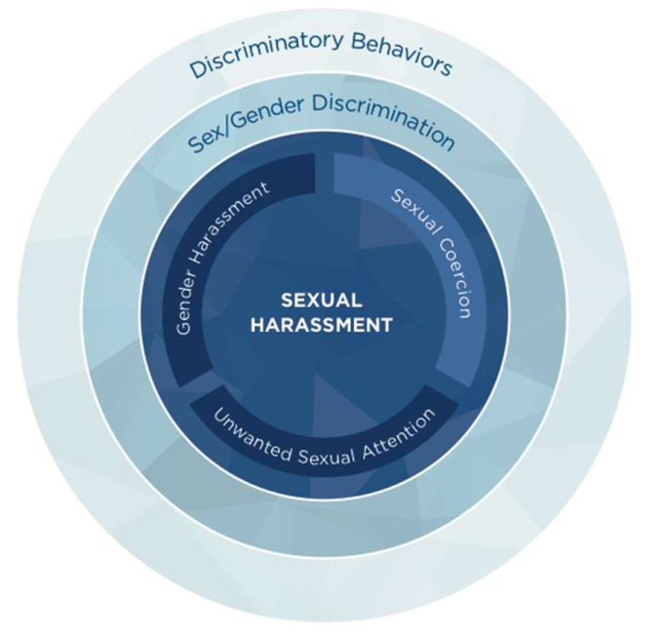
Sexual harassment of Women: National Academies
Sexual harassment is a form of discrimination that consists of three types of harassing behavior:
gender harassment
unwanted sexual attention
sexual coercion
The distinctions between the types of harassment are important, particularly because many people do not realize that gender harassment is a form of sexual harassment.

Slide 19
Sexual harassment of Women: National Academies
Sexual harassment remains a persistent problem in the workplace at large, and can be categorized as a public health epidemic.
Women experience sexual harassment more often than men do. Women of color and non-binary women experience more harassment than white women.
Gender harassment (e.g., behaviors that communicate that women do not belong or do not merit respect) is by far the most common type of sexual harassment.
Sexually harassing behaviors are not typically isolated incidents.
Legal compliance is necessary but not sufficient to reduce harassment
Changing climate and culture can prevent and effectively address sexual harassment.

Slide 20
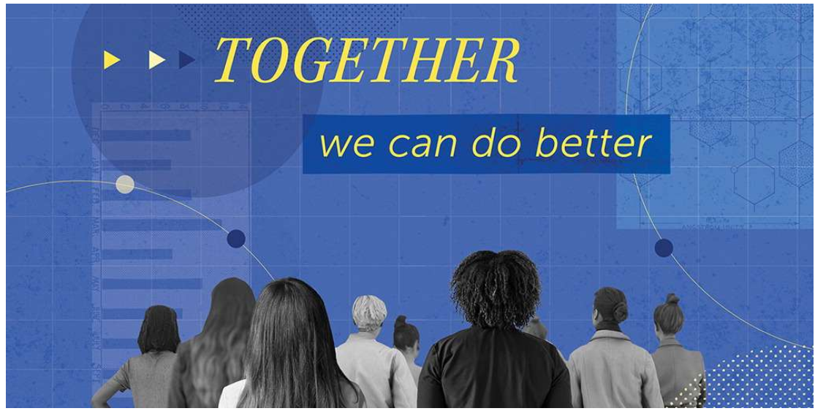

Slide 21
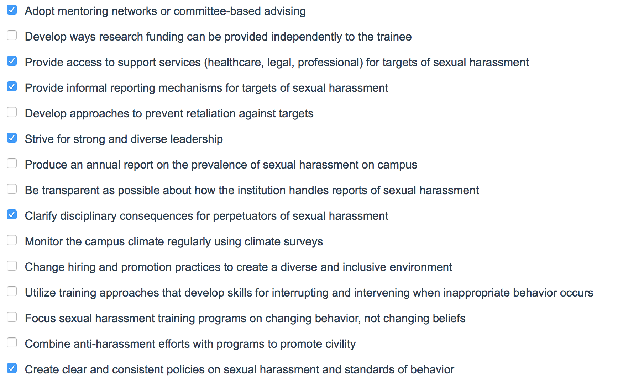
Recommendations

